Slide 1
The College Application Process Central Bucks East High School Counseling Dept.
This Photo by Unknown author is licensed under CC BY-SA.

Slide 2
Counselors
Mrs. Kozman– ckozman@cbsd.org- In C 106
School Counseling Assistant and a great resource!
Ms. Russo- mrusso@cbsd.org (A-CRO)
Mr. Sandstrom wsandstrom@cbsd.org (CRP-HAN)
Ms. Bryant-Gray- tbryantgray@cbsd.org (HAO-LZ)
Mrs. Barone-Durant- tdurant@cbsd.org (M-PR)
Mr. Moustakas- gmoustak@cbsd.org (PS-SMA)
Mrs. Jones- mejones@cbsd.org (SMB-Z)

Slide 3
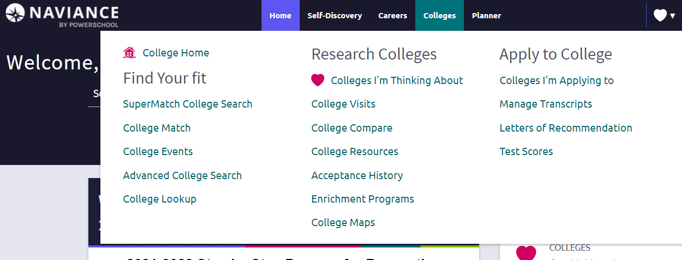
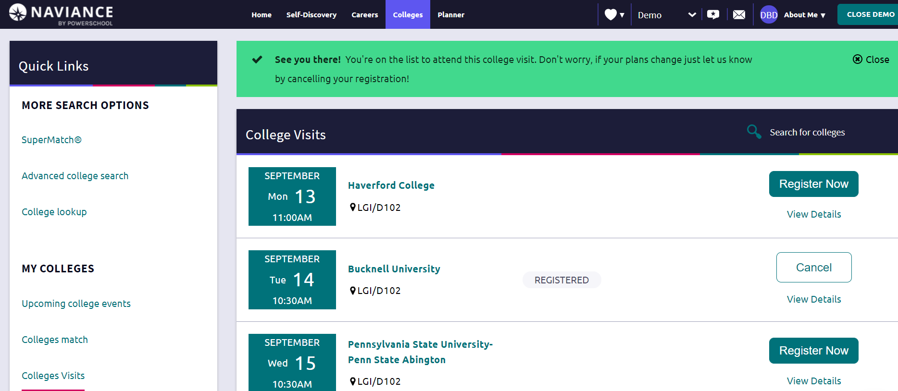
How to Sign-up for College Admissions Visits to CB East

Slide 4
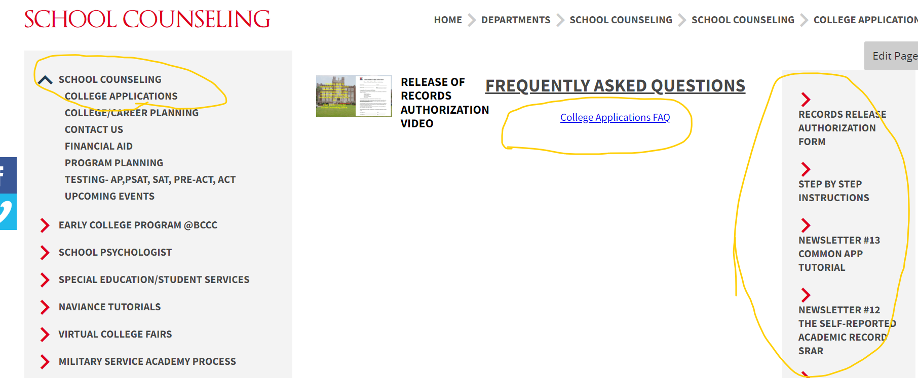
CB East College Application Site
Step-by-step instructions
(right hand side of page)

Slide 5
College Application Deadlines
Rolling
Apply early because colleges make their decisions as applications come in (typically by October 15th to maximize chances)
Once the class is full they will stop taking applications
Early Action (EA) November
Non-binding. Can apply to multiple colleges through EA.
Single-Choice Early Action: Non-binding, Communicates high interest, but only can apply to one college and nothing through ED
Early Decision (ED 1 and ED2) November & January
Binding, usually notified of decision by winter break
Only can apply to one school ED
May increase chance for admission.
Must sign an ED agreement: parent, student and counselor
Regular January - March
Apply by deadline set and usually find out in March/April
May increase chance for admission.

Slide 6
Deadlines for popular schools
Temple University
November 1st – Early Action
Penn State University
Modified Rolling Admissions
November 1st – Early Action, we recommend applying EA to Penn State
University of Pittsburgh
Rolling Admission (we advise by Oct. 15th) but if you want to be considered for scholarships you must apply by December 1st
PA State Universities (14 in total)
Ex: West Chester, Bloomsburg, Indiana University of PA
Home | PA State System of Higher Education
Rolling Admission (we advise Oct. 15th)
System Redesign: Northeast and West Plans
System Redesign | PA State System of Higher Education

Slide 7
Step-by-Step Instructions
Step 1: Release of Records
Step 2: Begin College Applications
Step 3: Requesting Transcripts
Step 4: Requesting Letters of Recommendation
Step 5: Submitting Test Scores
Click here for the Step by Step Instructions Guide

Slide 8
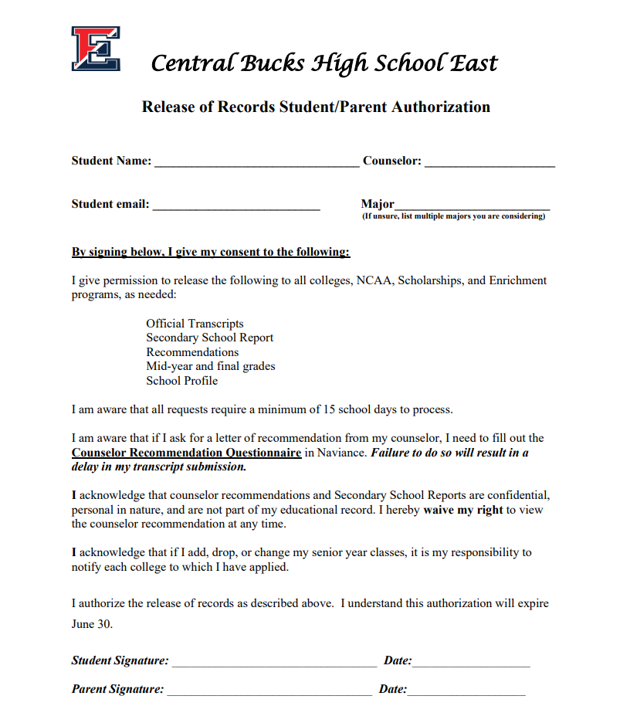
Step 1: Release of Records
This form must be completed for us to send your transcripts, recommendations, or other school records to colleges, scholarships, military, NCAA, etc.
Sign and return this form to Ms. Kozman at ckozman@cbsd.org or drop it off in C106 (school counseling office).

Slide 9
Step 2: Begin College Applications
College Specific Applications
Some colleges create their own application
The Coalition for College Application
150+ colleges accept it; open now
http://www.coalitionforcollegeaccess.org/
The Common Application
Over 1,000 colleges accept it
https://www.commonapp.org/

Slide 10
Matching Common App & FERPA Waiver
Create Common App account Please watch the video for instructions on how to match your Common App with Naviance!
Add colleges to Common App account
Add colleges into Naviance via “colleges I’m applying to”
Click on pink box: Match Accounts
Input your Common App email address
Always remember common app password
Waive your rights on FERPA waiver
Common App Account Matching Video

Slide 11
Step 3: Requesting Transcripts
You cannot request a Transcript through Naviance until you have:
Submitted your signed Release of Records form (Step 1); and
If using Common App: Created account; completed most sections; Matched with Naviance, and submitted FERPA waiver (Step 2). If you have completed these steps, then proceed.
Please remember to provide us with a minimum of 15 school days notice prior to your college deadline.
Videos to assist with steps below:
Add Colleges I'm Applying To in Naviance
Requesting Transcripts in Naviance

Slide 12
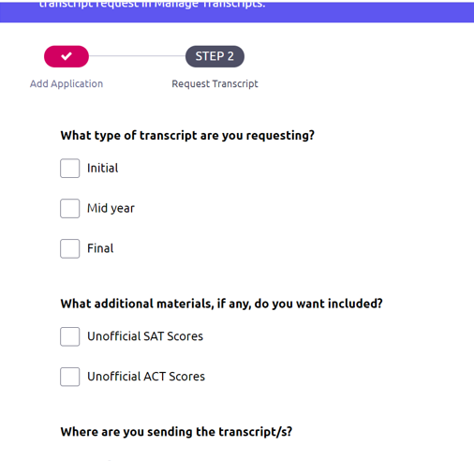
Step 3: Requesting Transcripts
Do not check either box. We will not send ANY
of your testing (official or unofficial) to colleges.

Slide 13
What is Sent When a Transcript is Requested
Transcript
Senior Schedule
School Profile
Secondary School Report
Please Note: We do not send ACT/SAT/AP scores

Slide 14
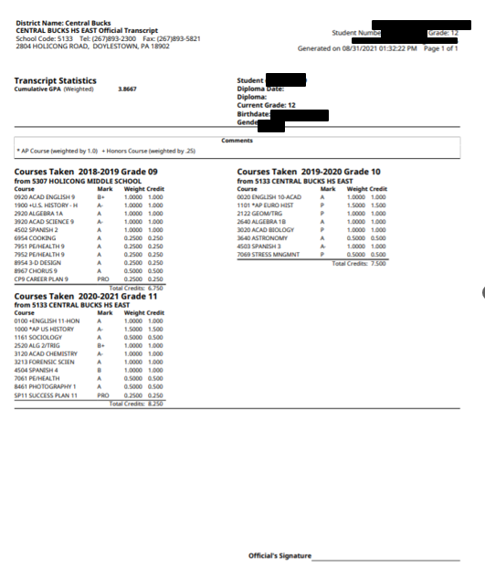
Example of a
Student Transcript
Shows all courses and final course grades from grades 9 through 11
The weighted Cumulative GPA is listed on the top left corner

Slide 15
Example of a Senior Year Schedule
Shows all courses for grade 12

Slide 16
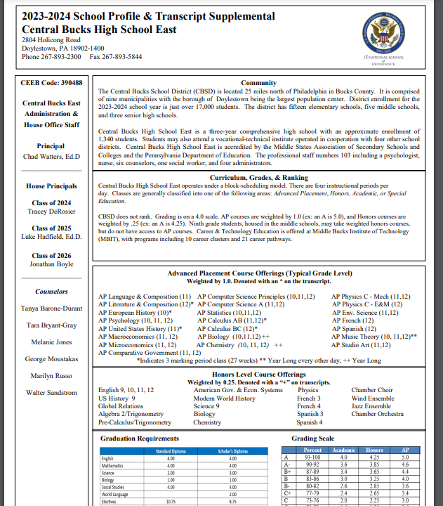
School Profile
This is updated annually, and it informs colleges of our credit requirements, Honors, AP offerings, as well as our grading scale.
This document helps colleges evaluate a student in the context of what is available at East.

Slide 17
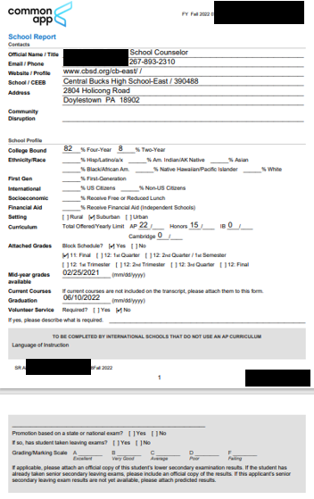
Secondary School Report (SSR)
This is a standard form that provides colleges with information they need to know about East and the applicant.
We have access to the SSR Common App form
If you’re applying to a college NOT through Common App, we will create a SSR for you!
There is no need to provide us with the SSR specific to your school.

Slide 18
Self-Reporting Academic Record (SRAR)
Some colleges ask students to self-report courses and grades
Examples: Penn State, Univ. of Pittsburgh, Univ of DE, Rutgers, etc.
Unofficial transcripts can be obtained through the student portal.
Complete the SRAR for these schools in addition to the application for admission:
Self-Reported Academic Record | Scarlet Computing Solutions (scarletcs.com) (selfreportedtranscript.com)
Even if you are self-report your grades through SRAR, the name of the school must be added to the “colleges I’m applying to” list in Naviance. This helps us to track your application.
However, since you are self-reporting, you do not need to check the “Initial” transcript box in Naviance to request a transcript.

Slide 19
Step 4: Requesting Letters of Recommendation
After you click the link below and the video starts you will then need to click:
Request LOR- Specific College
Do Not click on Request LOR - General
Student Letter of Recommendation Request Video

Slide 20
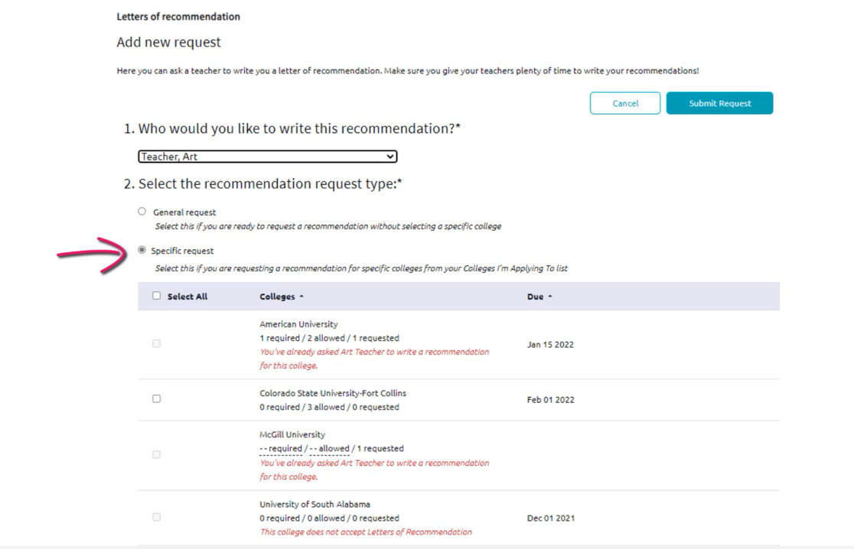

Slide 21
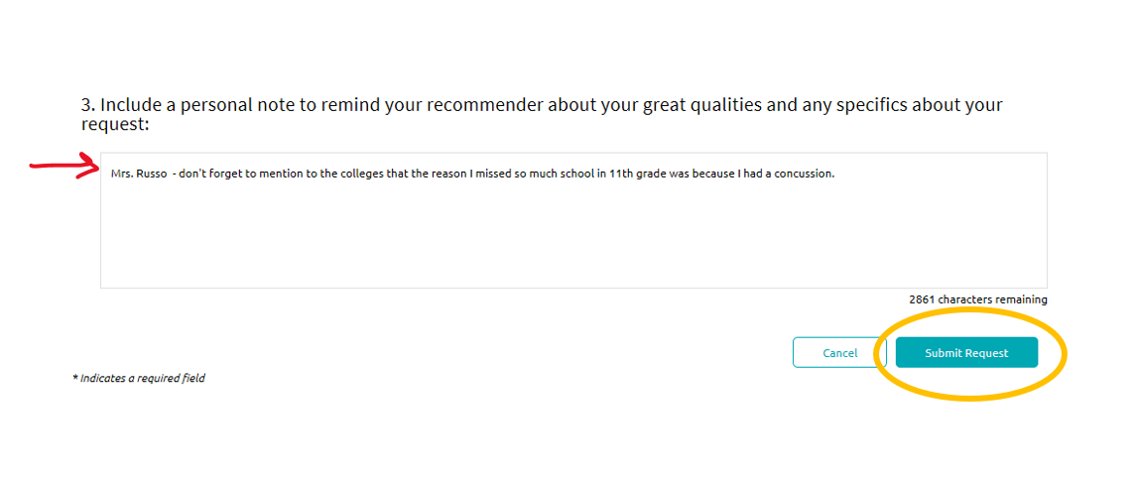

Slide 22
Counselor Letters of Recommendation

Slide 23
Requesting Counselor Letters-(Only if Required) Reminder - 15 school days notice in advance of deadlines is required
Drop off completed form to Mrs. Kozman in C106

Slide 24
Step 5: Submitting Test Scores (if applicable)
Make requests for your SAT/ACT scores to be sent directly from the testing agency to the college www.collegeboard.com and/or www.act.org
No test scores will be included on the transcript or with your documents CB East sends.
Visit College Board and ACT websites for processing time frames.

Slide 25
After you submit your application… 1st MP GRADES
Some colleges may request 1st MP before making an admissions decision.
Please see Mrs. Kozman in C106 if a college requests 1st mp grades.
1st MP grades should be sent only if the college requests it. Sending information to colleges they do not want will often slow the application review process and does not help admissions chances. Remember: Always follow the college’s specific admissions instructions.

Slide 26
Lunch and Learn College Application Work sessions
Come during Lunch and Learn (A or B) to ask any college application questions.
Dates:
Wednesday, September 13
Thursday, September 14
Friday, September 15 (B Lunch only)
Bring your laptop and questions ☺

Slide 27
We are here to help you!
Mrs. Kozman– ckozman@cbsd.org; 267-893-2310
School Counseling Assistant and a great resource!
Ms. Russo- mrusso@cbsd.org (A-CRO)
Mr. Sandstrom wsandstrom@cbsd.org (CRP-HAN)
Ms. Bryant-Gray- tbryantgray@cbsd.org (HAO-LZ)
Mrs. Barone-Durant- tdurant@cbsd.org (M-PR)
Mr. Moustakas- gmoustak@cbsd.org (PS-SMA)
Mrs. Jones- mejones@cbsd.org (SMB-Z)

